Slide 1
Comparing Leadership Models

Slide 2
Before you are a leader, success is all about growing yourself. When you become a leader, success is all about growing others. -Jack Welch
\
Notes:
“Before you are a leader, success is all about growing yourself. When you become a leader, success is all about growing others.” -Jack Welch
Retrieved from: https://boldomatic.com/p/jS-jPw/before-you-are-a-leader-success-is-all-about-growing-yourself-when-you-become-a

Slide 3
Introduction
Characteristics of the Universal Model of Leadership
Characteristics of Transformational Leadership
Compare and contrast both models
Significance of both models in business
Notes:
Some indicators of a good leader are effective communication, accountability, confidence, active listener/observer, how well he/she challenges others, and when to take appropriate corrective action. As a leader you must work well with others and consistently strive to develop your team to be successful. There are many different definitions and perspectives of what a leader entails. Leadership indicates a certain set of qualities and characteristics that can lead a group of people to successful results. Mostly this term is coined within organizations and in the workplace, but a leader, in my opinion, is not confined by the walls of an organization. The research on leadership may suggest that a leader is born into the position, or they have specific traits that enable them to lead. Personal experience has shown that everyone in higher positions are not always suitable for the leadership role. One take away from this course is that an individual may view themselves as a leader; however, it may take objective perspectives including self-assessments to show someone their true attributes.
In this presentation, I will compare and contrast two models of leadership, noting similarities and differences. I will also develop a conclusion regarding the significance of those models in business.

Slide 4
The Universal Model of Leadership
The Universal Model of Leadership focuses on restructuring the development of the individual to achieve higher performance
360° framework in developing leadership
Task-Relationship application
Five stages of development:
Egocentric
Reactive
Creative
Integral
Unitive
Notes:
The Universal Model of Leadership is a model that explores the progressive development of an individual. These stages are egocentric, reactive, creative, integral, and unitive. The idea is that every individual is not born into leadership, but similar to the mental, physical, emotional and situational development of a child to an adult, a leader has to train and consciously develop him/herself for the role. A significant part of the model is the identity of the individual as well. We all desire to belong or have a purpose in this world. It is important to know and be secure in our identity as it propels our confidence and the way we present ourselves to others. The goal is to never stop learning as the world is evolving daily in training, technology and consciousness.

Slide 5
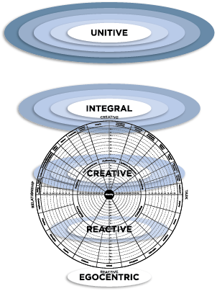
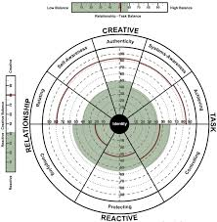
The Universal Model of Leadership
Notes:
Retrieved from: Adams, W. A., Anderson, J. J. (2016). Mastering Leadership: An Integrated Framework for Breakthrough Performance and Extraordinary Business Results. Hoboken, NJ: John Wiley & Sons

Slide 6
Transformational Leadership
Transformational leadership is about inspiring employees to perform beyond expectations
Consists of two major elements:
Transactional and Transformational
Consists of four roles:
Idealized influence
Inspirational motivation
Intellectual stimulation
Individualized consideration
Notes:
Hooijberg states “Transformational leadership is about inspiring employees to perform beyond expectations. It consists of two major elements: transactional and transformational” (2013, p. 898). He goes on to further explain, transformational leaders use rewards and punishment to induce certain behaviors in followers and they do so by “inspiring followers to go beyond mere transactional exchanges and consists of four roles: idealized influence, inspirational motivation, intellectual stimulation, and individualized consideration,” (Hooijberg, 2013, p. 898).
A transformational leader uses idealized influence by behaving as a “role model for their followers,” Hooijberg,2013, p. 898). By modeling ethical behaviors, upholding the values of the organization, and “being consistent in their pursuit of goals,” these leaders inspire trust and respect (Kinicki & Williams, 2015, p. 465). These leaders inspire by sharing a vision for the organization, and they do so with charisma, defined by Kinicki & Williams as “a form of interpersonal attraction that inspires acceptance and support” (2015, p. 464). Transformational leaders encourage their employees to think creatively and think of innovative solutions to problem. They are gifted at communicating the organization’s strengths, weaknesses, opportunities, and threats so that subordinates develop a new sense of purpose,” (Kinicki & Williams, 2015, p. 465). Lastly transformational leaders are employees who “actively encourage them to grow and to excel by giving them challenging work, more responsibility, empowerment, and one-on-one mentoring,” (Kinicki & Williams, 2015, p. 465).

Slide 7
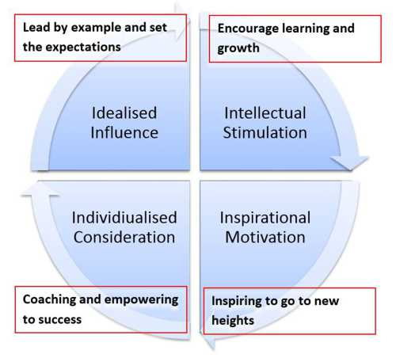
Transformational Leadership
Notes:
Retrieved from: http://www.educational-business-articles.com/transformational-leadership/

Slide 8
Comparison of Models
Agrees that a leader is not born, but developed.
Focuses on restructuring the leader/manager/supervisor, and the sustainment of the organizational goals.
Both models can expand across cultures, genders, etc.
Leaders take accountability for their current skills, and thus train and develop to a positive, inclusive and forward thinking leadership approach.
Extensions of existing theories (i.e. – Universal is an extension of the Keagan approach and Transformational is an extension of Trait theory approach).
Seek to develop the leadership capabilities of surrounding employees.
Notes:
Here are a few similarities of the Universal Model and Transformational Leadership. The models focus on restructuring the leader that consequentially have a positive effect on the organization in work performance.

Slide 9
Differences of Models
Universal Model of Leadership
Transformational Leadership
Development proceeds from lower to higher-order Structures of Mind through a series of well-mapped and researched stages (Adams, W. A., Anderson, J. J. 2016).
Restructures leadership style based on identity and the perspective of the surrounding environment.
Utilizes the LCP 360° assessment framework in developing leadership.
Focuses on the transformation of the consciousness of leader.
Followers remain subordinates of the transformational leader, regardless of whatever else might be transformed” (Wren, 1995, p 104-106).
Develops traits based on the organization
Focus on the characteristic of charisma and similar traits.
Reliance on proper training and development.
Notes:
Here are a few of the differences between the two models of leadership.

Slide 10
Significance
Significant influence on:
The confidence and creative approach of leadership
Work performance
Improved employee engagement, productivity, and morale
Models are based on research and application.
The models illustrate examples of success; however, different leadership styles are suited to different situations.
The organization will be successful based on the commitment to the model of leadership they choose to implement.
Notes:
Leadership has been described “in essence, a process: a series of actions and interactions among leaders and followers which lead to the attainment of group goals” (Wren, 1995, p. 325). Leadership styles and theories are essential to an organization’s structure, culture, and development. Working under positive and encouraging leadership can increase employee performance, engagement and morale. Overtime the idea of leadership roles and duties have changed. In the past, many companies focused on an authoritarian approach that was less inclusive and left no room for individual creativity. Even training protocols change often in fields that I have worked in. The significance of the models is the commitment that each organization takes to change the environment for the better. It illustrates how aware the organization is of its current standing and how it plans to adapt to a beneficial approach for long-term sustainment of present and future goals.

Slide 11
References
Adams, W. A., Anderson, J. J. (2016). Mastering Leadership: An Integrated Framework for Breakthrough Performance and Extraordinary Business Results. Hoboken, NJ: John Wiley & Sons.
Hooijberg, R. (2013). Transformational theory of leadership. In E. Kessler (Ed.), Encyclopedia of management theory (Vol. 2, pp. 897-899). Thousand Oaks,: SAGE Publications Ltd. doi: 10.4135/9781452276090.n301
Kinicki, A., Williams, B. (2015). Management, 7th Edition. Retrieved from https://bookshelf.vitalsource.com/books/1259723542
Landis, E. A., Hill, D., & Harvey, M. R. (2014). A synthesis of leadership theories and styles. Journal of Management Policy and Practice, 15(2), 97-100. Retrieved from https://search-proquest-com.contentproxy.phoenix.edu/docview/1535935047?accountid=35812
Wren, J.T. (1995). The leader’s companion: Insights on leadership through the ages. New York: The Free Press. Yukl, G.A.

